Slide 1
Advanced Search (Optimization)

Slide 2
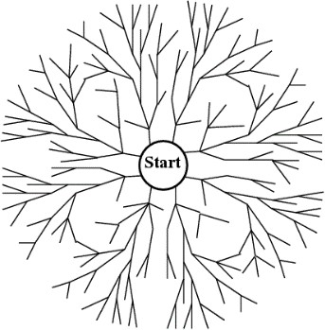



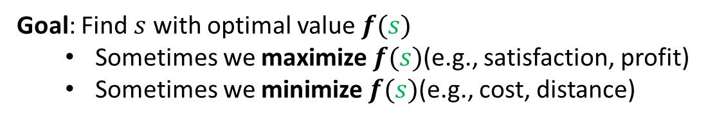
Search vs. Optimization
Before, the goal was simply to find a path from the start state to the goal state using search strategies such as uninformed methods or informed approaches like A*.
New setting: Optimization
States $s$ have values $f(s)$
Goal: Find $s$ with optimal value $f(s)$
Sometimes we maximize $f(s)$(e.g., satisfaction, profit)
Sometimes we minimize $f(s)$(e.g., cost, distance)
Challenge: Too many states for uninformed and informed approaches
Cannot enumerate all paths
Function may not be differentiable (cannot use gradient descent)

Slide 3
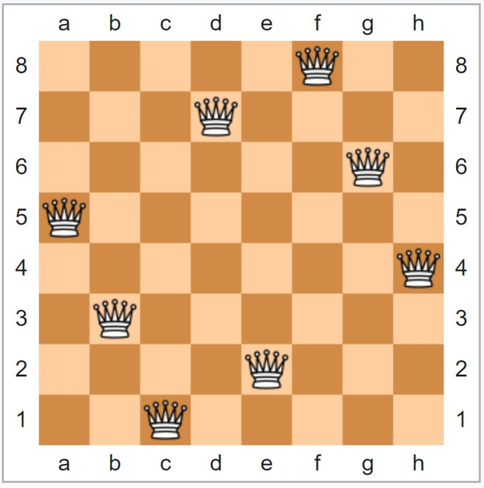

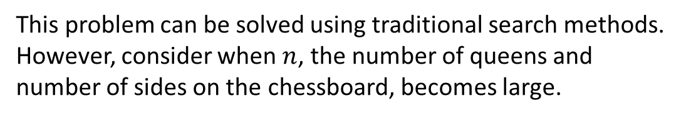
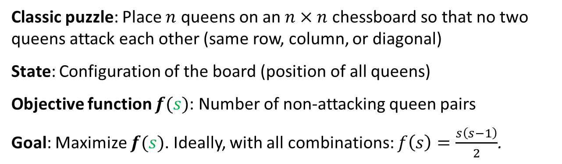
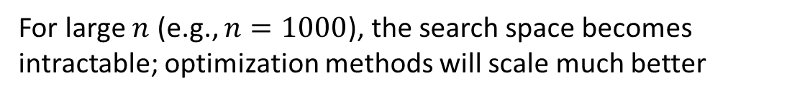
$n$-Queens
Classic puzzle: Place $n$ queens on an $n×n$ chessboard so that no two queens attack each other (same row, column, or diagonal)
State: Configuration of the board (position of all queens)
Objective function $f(s)$: Number of non-attacking queen pairs
Goal: Maximize $f(s)$. Ideally, with all combinations: $f\left(s\right)=\frac{s\left(s−1\right)}{2}$.
Why optimization instead of search?
Ug!
This problem can be solved using traditional search methods. However, consider when $n$, the number of queens and number of sides on the chessboard, becomes large.
For large $n$ (e.g., $n=1000$), the search space becomes intractable; optimization methods will scale much better
nano banana

Slide 4
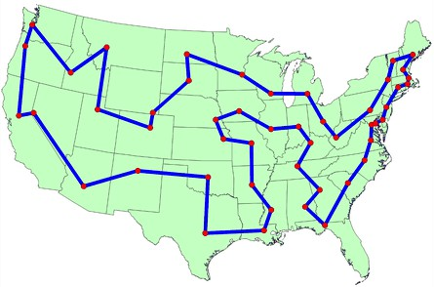

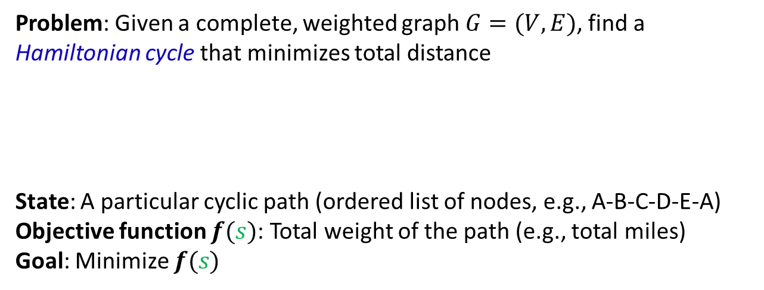
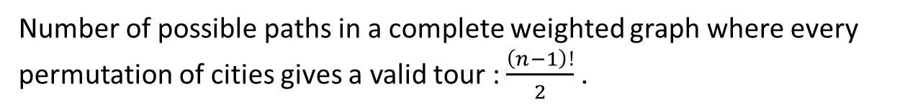
Traveling Salesperson Problem (TSP)
Problem: Given a complete, weighted graph $G=(V, E)$, find a Hamiltonian cycle that minimizes total distance
State: A particular cyclic path (ordered list of nodes, e.g., A-B-C-D-E-A)
Objective function $f(s)$: Total weight of the path (e.g., total miles)
Goal: Minimize $f(s)$
Visits each node exactly once
Returns to the initial node
Minimizes total distance
Why optimization instead of search?
Number of possible paths in a complete weighted graph where every permutation of cities gives a valid tour : $\frac{\left(n−1\right)!}{2}$.
Ug!
For $n=10$ cities, there are ~181,000 tours; $n=20$ → ~60 quintillion.
Even with good heuristics (e.g., MST), A* does not scale due to exponential state space and memory requirements
We only need the best tour, not the path to find it

Slide 5

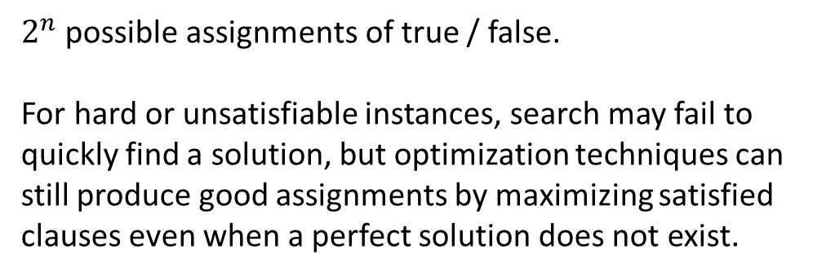
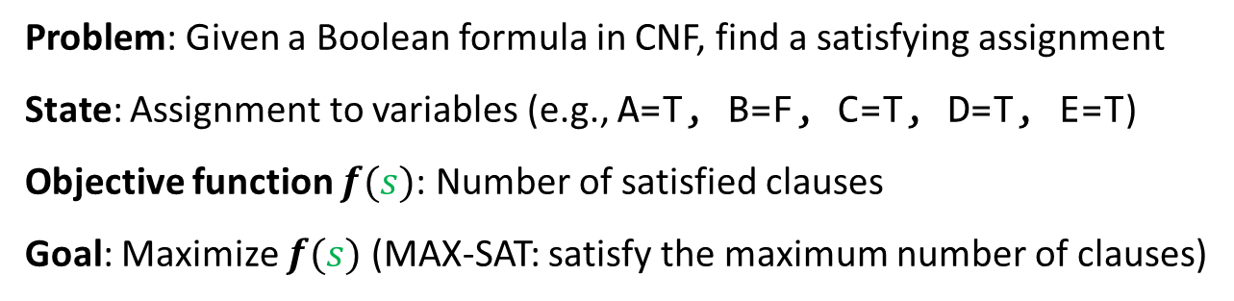
Boolean Satisfiability
Example
(A ∨ ¬B ∨ C) ∧
(¬A ∨ C ∨ D) ∧
(B ∨ D ∨ ¬E) ∧
(¬C ∨ ¬D ∨ ¬E) ∧
(¬A ∨ ¬C ∨ E)
Problem: Given a Boolean formula in CNF, find a satisfying assignment
State: Assignment to variables (e.g., A=T, B=F, C=T, D=T, E=T)
Objective function $f(s)$: Number of satisfied clauses
Goal: Maximize $f(s)$ (MAX-SAT: satisfy the maximum number of clauses)
Why optimization instead of search?
$2^{n}$ possible assignments of true / false.
For hard or unsatisfiable instances, search may fail to quickly find a solution, but optimization techniques can still produce good assignments by maximizing satisfied clauses even when a perfect solution does not exist.

Slide 6

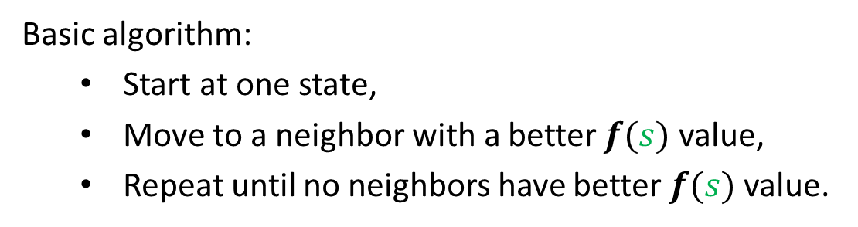
Hill Climbing
Basic algorithm:
Start at one state,
Move to a neighbor with a better $f(s)$ value,
Repeat until no neighbors have better $f(s)$ value.
Critical Question: How do we define neighbor?
Neighbors refer to states reachable by a single action from current state
In optimization, we have more freedom in defining actions than in path-finding
Path-finding: actions often dictated by problem structure (roads, legal moves)
Optimization: we choose what counts as an action (which queen to move? how to modify tour?)
This design choice significantly impacts algorithm performance
Requires careful consideration of tradeoffs

Slide 7
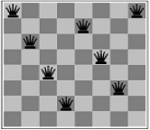
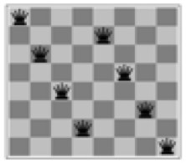
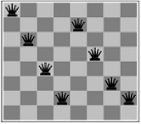
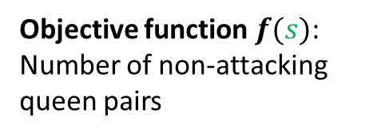
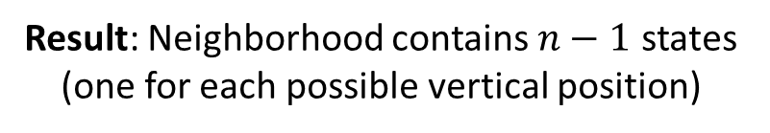
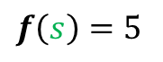
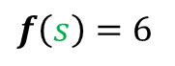
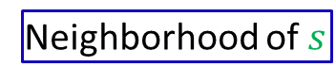
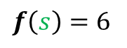
Defining Neighbors: $n$-Queens
Approach: Small changes to current state
Look at the most-conflicting column (if a tie, choose the rightmost column)
Move queen in that column vertically to a different location
Result: Neighborhood contains $n−1$ states (one for each possible vertical position)
$f\left(s\right)=6$
…
Neighborhood of $s$
$f\left(s\right)=5$
$f\left(s\right)=6$
Objective function $f(s)$: Number of non-attacking queen pairs

Slide 8
Defining Neighbors: Traveling Salesperson Problem I
Approach: 2-change operation
Select two edges to remove
Flipping the edges between the removed edges
Reconnect the tour to the flipped edges
D
C
A
Original tour: A-B-C-D-E-F-G-H-A
B
Select two edges to remove:
E
(B,C) and (E,F)
A-B C-D-E F-G-H-A
H
Reverse the edges in-between:
F
G
C-D-E → E-D-C
A-B E-D-C F-G-H-A
Reconnect the tour with the reversed elements:
A-B-E-D-C-F-G-H-A
Our new tour.

Slide 9
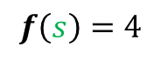
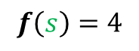
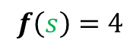
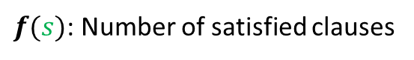
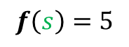
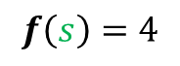
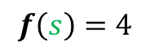
Defining Neighbors: SAT
Example
(A ∨ ¬B ∨ C) ∧
(¬A ∨ C ∨ D) ∧
(B ∨ D ∨ ¬E) ∧
(¬C ∨ ¬D ∨ ¬E) ∧
(¬A ∨ ¬C ∨ E)
Approach: Flip one variable assignment
Example:
Starting state (A=T, B=F, C=T, D=T, E=T)
$$f\left(s\right)=4$$
Resulting Neighborhood:
(A=F, B=F, C=T, D=T, E=T)
(A=T, B=T, C=T, D=T, E=T)
(A=T, B=F, C=F, D=T, E=T)
(A=T, B=F, C=T, D=F, E=T)
(A=T, B=F, C=T, D=T, E=F)
$$f\left(s\right)=4$$
$$f\left(s\right)=4$$
$$f\left(s\right)=5$$
$$f\left(s\right)=4$$
$$f\left(s\right)=4$$
$f(s)$: Number of satisfied clauses

Slide 10
Hill Climbing: Tradeoffs
Vaguely: for a given problem structure, neighbors are states that can be produced by a small change.
What is a neighbor?
Neighborhood too small?
Algorithm gets stuck in local optima
The Tradeoff!
Neighborhood too large?
Algorithm is inefficient (too many neighbors to evaluate)
How to pick next state?
Greedy: Choose best neighbor
When to terminate?
When no neighbor has better value than current state

Slide 11
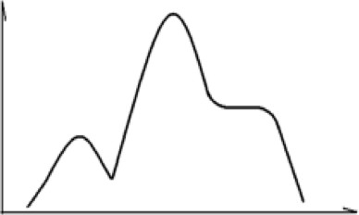
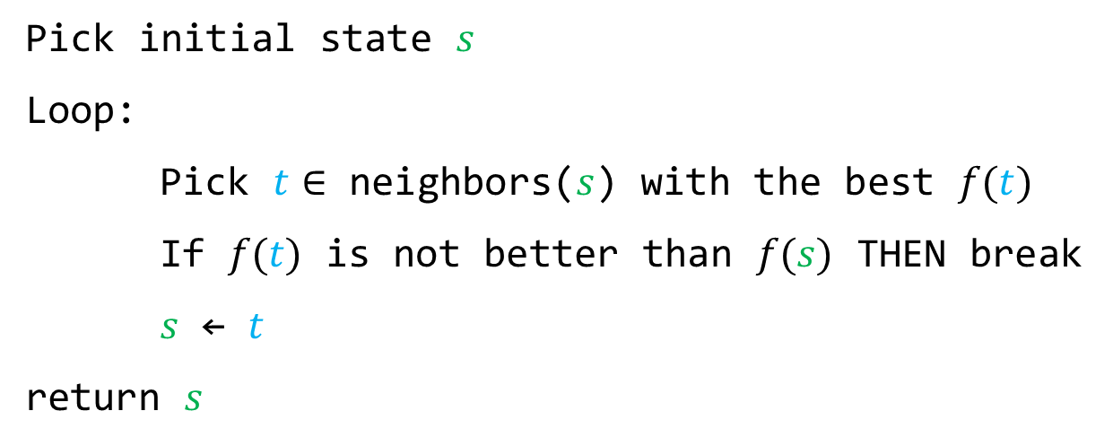
Hill Climbing Algorithm
Pick initial state $s$ Loop:
Pick $t∈$ neighbors($s$) with the best $f(t)$ If $f(t)$ is not better than $f(s)$ THEN break $s$ ← $t$
return $s$
The algorithm stops when no neighbor is better
What could have happened?
Local optima!
We may have found a “local optimum,” not a “global optimum”

Slide 12
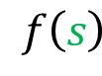
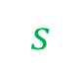

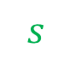
Hill Climbing: The Local Optima Problem
Our space is a complex landscape with multiple optima.
Our goal is to find the global optimum.
But we can only see locally: fog obscures everything except immediate neighbors
The result is that we climb to a local optimum and stop, even though a global optimum exists elsewhere.
Global optimum: what we want to find
$$f\left(s\right)$$
FOG
$$f\left(s\right)$$
$$s$$
$$s$$
What is actually going on
What we see

Slide 13
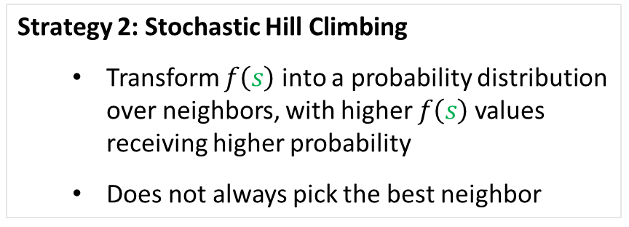

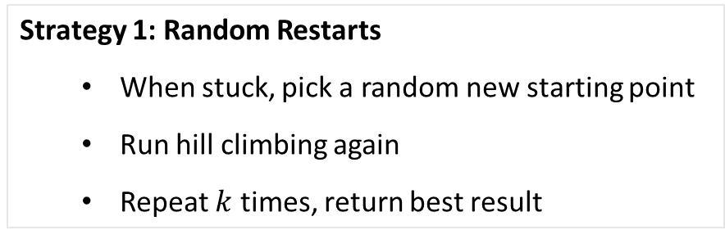



Hill Climbing: Escaping Local Optima
Where do I go?
$$f\left(s\right)$$
Done?
FOG
$$f\left(s\right)$$
FOG
$$s$$
$$s$$
How do we escape Local optima?
Strategy 1: Random Restarts
When stuck, pick a random new starting point
Run hill climbing again
Repeat $k$ times, return best result
Strategy 2: Stochastic Hill Climbing
Transform $f\left(s\right)$ into a probability distribution over neighbors, with higher $f\left(s\right)$ values receiving higher probability
Does not always pick the best neighbor

Slide 14

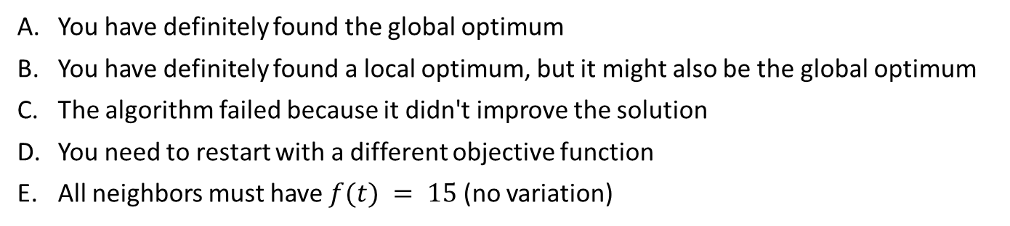
Questions
A hill climbing algorithm is solving a scheduling problem. After 50 iterations, it finds a solution with $f(s) = 87$. After 500 more iterations, we still have $f(s) = 87$. What is the BEST next step?
Declare the problem unsolvable and try a different algorithm
Continue running hill climbing longer—it just needs more time
Use random restart: pick a new random initial state and run hill climbing again
Reduce the neighborhood size to find smaller improvements
Increase the neighborhood size to explore more options
You are using hill climbing to solve a problem. The algorithm stops at a state where $f(s) = 15$, and all neighbors have $f(t) ≤ 15$. Which of the following is TRUE?
You have definitely found the global optimum
You have definitely found a local optimum, but it might also be the global optimum
The algorithm failed because it didn't improve the solution
You need to restart with a different objective function
All neighbors must have $f(t) = 15$ (no variation)

Slide 15
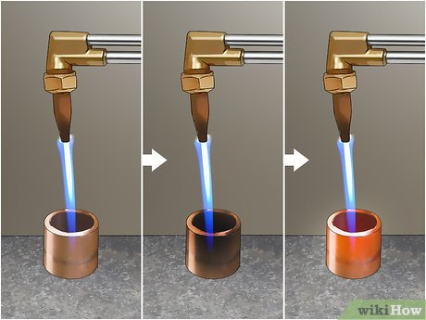

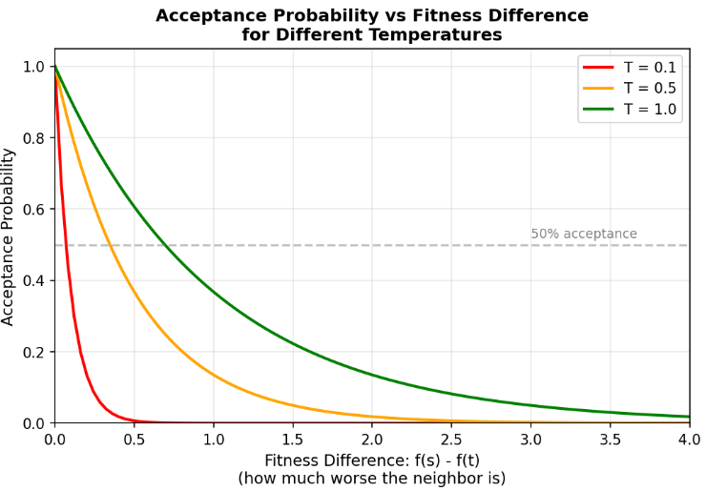
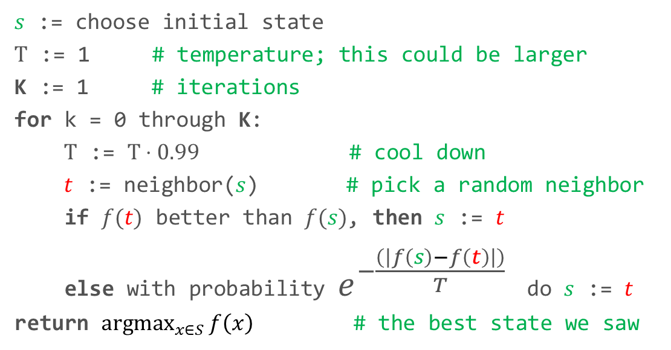
Simulated Annealing
Inspiration: Annealing strengthens metal by heating it and cooling it slowly, relieving internal stresses and creating a uniform crystal structure.
Algorithmic analog: Allow “bad” moves early (high temperature) then cool by becoming increasingly selective over time; eventually behaving like hill climbing (low temperature).
wikihow.com
The Probability Formula:
Borrowed from physics (Boltzmann distribution in thermodynamics)
Gives desired properties: gradual transition from exploration to exploitation
The exponential decay naturally handles the temperature cooling
$s$ := choose initial state
$T$ := 1 # temperature; this could be larger K := 1 # iterations
for k = 0 through K: $T$ := $T⋅0.99$ # cool down $t$ := neighbor($s$) # pick a random neighbor if $f(t)$ better than $f(s)$, then $s$ := $t$ else with probability $e^{−\frac{\left(\left|f\left(s\right)−f\left(t\right)\right|\right)}{T}}⁡$ do $s$ := $t$ return ${argmax}_{x∈S}{f\left(x\right)}$ # the best state we saw

Slide 16
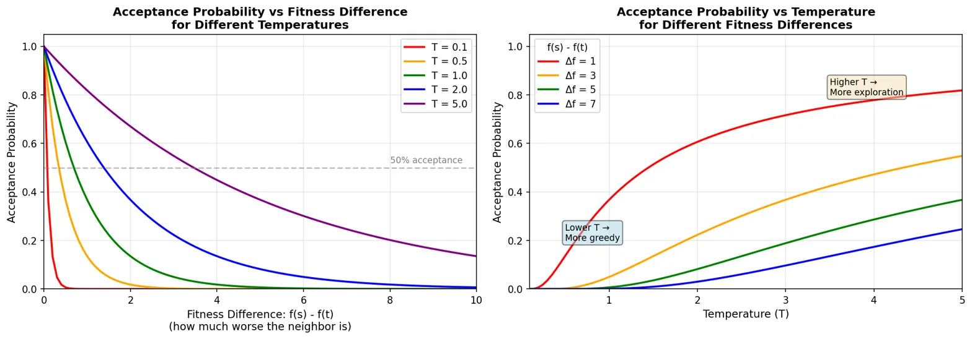
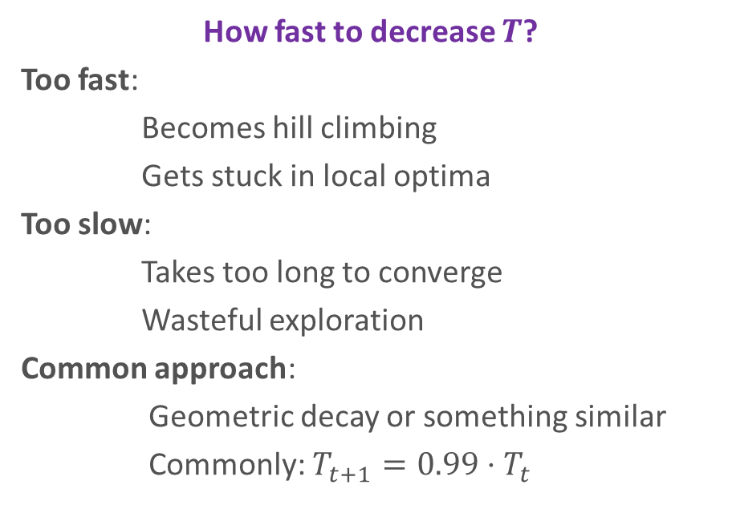
Simulated Annealing: Temperature Cooling Schedule
How fast to decrease $T$?
Too fast:
Becomes hill climbing
Gets stuck in local optima
Too slow:
Takes too long to converge
Wasteful exploration
Common approach:
Geometric decay or something similar
Commonly: $T_{t+1}=0.99⋅T_{t}$
Phase | Temperature | Acceptance of Worse Moves | Goal
Early | High | Frequent | Exploration
Middle | Moderate | Occasional | Refinement
Late | Low | Rare | Convergence
Evolution over time

Slide 17

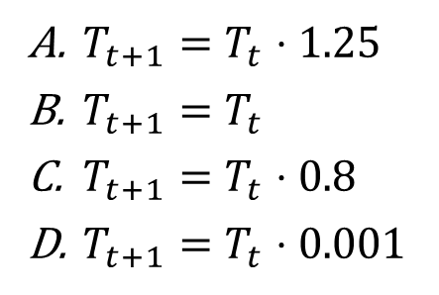
Question
Which of the following is likely to give the best cooling schedule for simulated annealing?
$T_{t+1}=T_{t}⋅1.25$
$T_{t+1}=T_{t}$
$T_{t+1}=T_{t}⋅0.8$
$T_{t+1}=T_{t}⋅0.001$
Temperate is increasing
Temperate is constant
Cools way too fast; basically, hill-climbing

Slide 18
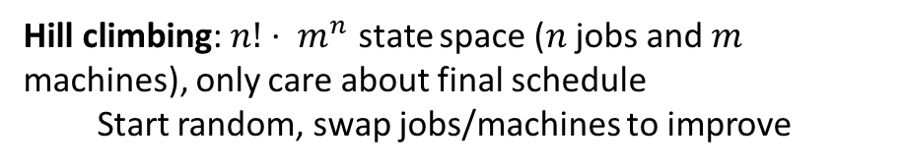
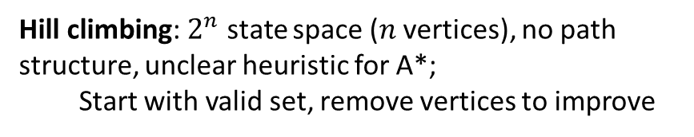
Questions
Distinction
Use A* when: small branching factor, want the path, good heuristic exists
Use hill climbing when: huge state space, only care about final solution, can define neighbors easily
Which of the following would be better to solve with hill climbing rather than A* search?
Finding the smallest set of vertices such that every edge in the graph has at least one endpoint in the set
Finding the fastest way to schedule jobs with varying runtimes on machines with varying processing power
Finding the fastest way through a maze
Hill climbing: $2^{n}$ state space ($n$ vertices), no path structure, unclear heuristic for A*;
Start with valid set, remove vertices to improve
Hill climbing: $n!⋅ m^{n}$ state space ($n$ jobs and $m$ machines), only care about final schedule
Start random, swap jobs/machines to improve
A*: Small branching factor, good heuristic (distance), need the path itself

Slide 19
Genetic Algorithms

Slide 20

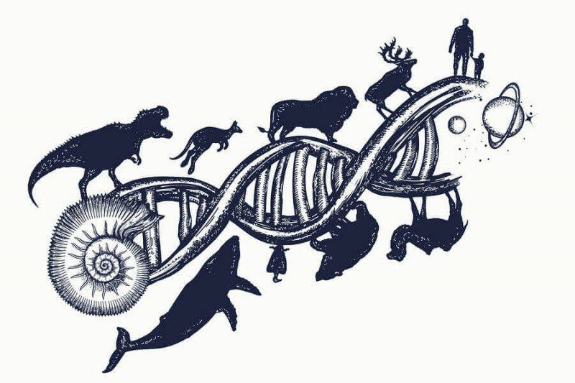
Genetic Algorithms
Inspiration: Biological Evolution
Algorithmic Analog
Organisms encode genetic information in DNA
Beneficial traits help survival and reproduction
Population evolves toward better fitness over generations
Encode solutions as “chromosomes”
Better solutions have higher “fitness”
Apply selection, crossover, and mutation

Slide 21
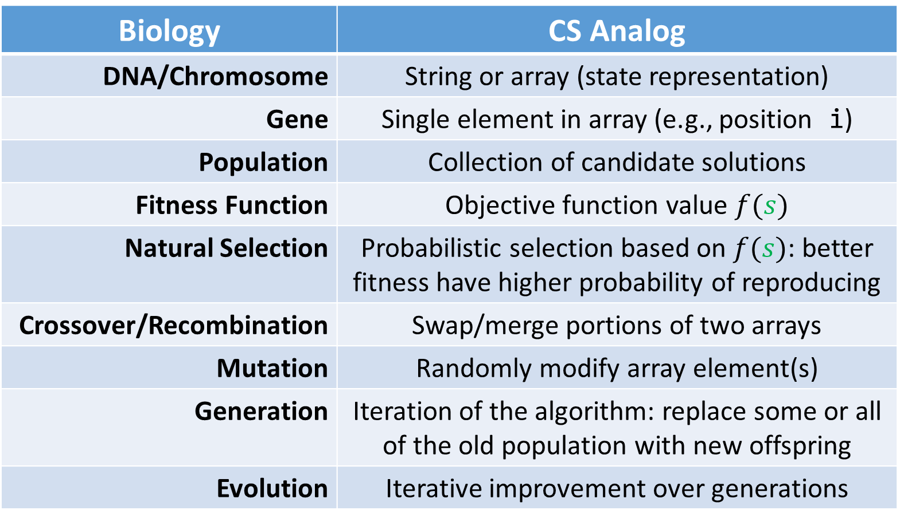
Genetic Algorithms: Biology ↔ Computer Science
Biology | CS Analog
DNA/Chromosome | String or array (state representation)
Gene | Single element in array (e.g., position i)
Population | Collection of candidate solutions
Fitness Function | Objective function value $f(s)$
Natural Selection | Probabilistic selection based on $f(s)$: better fitness have higher probability of reproducing
Crossover/Recombination | Swap/merge portions of two arrays
Mutation | Randomly modify array element(s)
Generation | Iteration of the algorithm: replace some or all of the old population with new offspring
Evolution | Iterative improvement over generations

Slide 22
Genetic Algorithm Pseudocode
# Probability Distribution based on fitness of individuals
Higher fitness → higher chance of being selected.
1. Let s₁, ..., s_{N} be the current population 2. Let pᵢ = f(sᵢ) / Σⱼf(sⱼ) be the reproduction probability 3. for k = 1; k < N; k += 2: parent1 = randomly pick according to pᵢ parent2 = randomly pick another Randomly select crossover point, swap substrings of parents 1, 2 to generate children t[k], t[k+1] 4. for k = 1; k ≤ N; k++: Randomly mutate each position in t[k] with small probability (mutation rate) 5. New generation replaces old: {s} ← {t}. Repeat.
# Crossover to create a pair of children
# Mutate: Possibly modify each gene (position) of each individual in the population
# Repeat the process with the next generation

Slide 23
Example
Student Request | # Students
A, B, C | 2
A, B, D | 7
A, D, E | 3
B, C, D | 4
B, D, E | 10
C, D, E | 5
Problem: Schedule 5 courses (A, B, C, D, E) into 3 time slots (Mon/Wed, Tue/Thu, Fri/Sat)
2 students want to take courses A, B, and C
Goal: Maximize the number of students who can enroll in all their desired courses
Individual/Chromosome/State: Assignment of courses to time slots
Example chromosome: MMFTM
Encoding: 5-character string (one character per course)
Character values: M (Mon/Wed), T (Tue/Thu), F (Fri/Sat)
Character positions: A = 1, B = 2, C = 3, D = 4, E = 5
A → Mon/Wed
B → Mon/Wed
C → Fri/Sat
D → Tue/Thu
E → Mon/Wed
Population: Collection of chromosomes
e.g. : { MMFTM, TTFMM, FMTTF, MTTTF }

Slide 24
Example: Fitness Calculation
What are we trying to optimize?
Maximize the number of students who can take all their desired courses
What defines a valid solution for each student?
Their requested courses must be scheduled in different time slots (no conflicts)
How do we quantify solution quality?
Count satisfied constraints (students who can enroll without conflicts)
$f(chromosome)$ = students who can enroll without conflicts

Slide 25
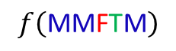
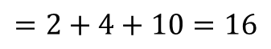
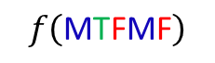
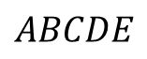

Example: Fitness Calculation
$f(chromosome)$ = students who can enroll without conflicts
$$ABCDE$$
$$f\left(\text{MM}\text{F}\text{T}\text{M}\right)$$
$$=4+5=9$$
$$f\left(\text{M}\text{T}\text{F}\text{M}\text{F}\right)$$
$$=2+4+10=16$$
Constraint (Student Request) | # Students
A, B, C | 2
A, B, D | 7
A, D, E | 3
B, C, D | 4
B, D, E | 10
C, D, E | 5
Constraint (Student Request) | # Students
A, B, C | 2
A, B, D | 7
A, D, E | 3
B, C, D | 4
B, D, E | 10
C, D, E | 5
Time Slots
M, M, F
M, M, F
M, T, M
M, F, T
M, T, M
F, T, M
Satisfied?
No
No
No
Yes
No
Yes
Time Slots
M, T, F
M, T, M
M, M, F
T, F, M
T, M, F
F, M, F
Satisfied?
Yes
No
No
Yes
Yes
No

Slide 26




Population and Parent Selection
Individual: $s$ | $$f(s)$$
MMFTM | 9
TTFMM | 4
FMTTF | 19
MTTTF | 3
$$\sim \%$$
26
11
54
9
For an initial population, we can randomly generate strings and and calculate their fitness:
$$\sum{f\left(s\right)}=35$$
A parent is an individual from the current population that is selected to contribute genetic material to create offspring for the next generation.
Selecting Parents
Just like Stochastic Hill Climbing, we:
Transform $f\left(s\right)$ into a probability distribution over individuals, with higher $f\left(s\right)$ values receiving higher probability
Does not always pick the best individual
FMTTF is most likely to be selected as a parent but is not guaranteed.

Slide 27
Crossover
Crossover is the operation of combining genetic material from two parents to create two children.
This is the way for the genetic algorithm to mix traits from different solutions to explore new combinations.
Parents
MMFTM
FMTTF
Crossover Point: Index 2
Offspring
MMTTF
FMFTM

Slide 28

Mutation
Mutation is is the operation of randomly modifying individual genes (elements) of a chromosome.
This is a way for a genetic algorithm to introduce new genetic variation and explore solutions beyond the current population.
The mutation rate controls how often mutations occur (in each position of an individual).
Mutation Rate ($μ$) | Behavior
0.001 (too low) | Rare mutations
0.05 (good) | Occasional mutations
0.5 (too high) | Frequent mutations
Result
Population lacks diversity, converges too quickly
Maintains diversity, steady improvement
Good solutions disrupted, poor convergence
Original
MMFTM
FMTTF
Mutated
MFFTM
FMFMM
Convergence: When individuals in the population become highly similar to each other and fitness values stabilize across generations.

Slide 29






The Next Generation
The Original Population
The Next Generation
Individual: $s$ | $$f(s)$$
MMFTM | 9
TTFMM | 4
FMTTF | 19
MTTTF | 3
$$\sim \%$$
26
11
54
9
Individual: $s$ | $$f(s)$$
FMFTT | 11
MMTTF | 13
MMTFF | 4
FTTTF | 0
$$\sim \%$$
39
46
14
0
selection, crossover, + mutation
Average fitness dropped: 8.75 → 7
Best fitness dropped: 19 → 13
Total fitness dropped: 35 → 28
$$\sum{f\left(s\right)}=35$$
$$\sum{f\left(s\right)}=28$$
We want to improve with each generation, but our next generation is worse!
One solution: Elitism! Always keep the best individual(s) from the previous generation; we can modify the algorithm as:
5. New generation replaces old: {s} ← {t}, except:
Keep the best k individuals from {s} in {t} (elitism)

Slide 30
Genetic Algorithms: Key Parameters and Variations
Parameter / Choice | Options | Recommendation
Population size | 20-200 | Larger for complex problems
Mutation Rate | 0.01-0.1 | Start with 1/n (n = chromosome length)
Generations | 100-10000 | Run until fitness plateaus
Selection | Proportional / Rank / Tournament | Rank-based reduces extreme fitness effects
Crossover | Single-point / Multi-point / Uniform | Single-point is standard, simple
Elitism | Yes / No | always keep best solution(s)
Variation | Description | Benefit
Elitism | Keep best k individuals from previous generation | Never lose best solution found
Rank-based selection | Use ranking instead of raw fitness values | Reduces influence of extreme fitness values
Multi-point crossover | Split at multiple positions instead of one | Increases genetic mixing
Adaptive mutation rate | Change μ over time (high → low) | More exploration early, exploitation later
Tournament selection | Pick best from random subset | Simpler than probability calculation
Choosing Variations
Elitism (Recommended): ensures best solution is never lost
Rank-based selection: Useful when fitness values vary widely
Adaptive parameters: requires tuning and experimentation
Could also train a neural network to recommend parameters

Slide 31

Genetic Algorithms: Challenges
Challenge | Problem | Solution Approaches
Encoding design | How to represent solutions as chromosomes? | Design so crossover is meaningful; Ensure mutations maintain validity
Premature convergence | All individuals become identical early | Higher mutation rate; Use niching techniques (methods to maintain diversity by encouraging different subpopulations to explore different regions of the search space.
Parameter selection | Choosing N, μ, crossover rate (whether to apply crossover), etc. | Use rules of thumb (μ = 1/n); Experiment; Adaptive parameters
Computational cost | Large populations $×$ many generations | GPU parallelization; Adaptive stopping criteria: No improvement stopping Convergence threshold Fitness target reached Rate of improvement is too slow

Slide 32
In Summary

Slide 33
Comparing the Three Approaches
Approach | Local Optima? | Population? | Randomness? | Parameters | Best For
Hill Climbing | Vulnerable | Single state | Deterministic | Neighborhood definition | Simple problems, try first
Simulated Annealing | Better escape | Single state | Probabilistic | Temperature, cooling rate | HC gets stuck
Genetic Algorithms | Best escape | Multiple states | Probabilistic | N, μ, selection, crossover | Hard, multimodal (many local optima) problems
Trade-offs
Hill climbing: Simplest, fastest per iteration, but gets stuck
Simulated annealing: More robust, requires tuning temperature
Genetic algorithms: Most complex, good for hard problems, many parameters

Slide 34
What We Saw
1. Optimization problems require different techniques than path-finding
2. Local search is efficient but can get trapped in local optima
3. Randomness helps escape local optima
4. Nature-inspired algorithms (annealing, evolution) provide powerful metaphors
Some Advice
Start simple (hill climbing)
Add sophistication as needed (simulated annealing, genetic algorithms)
Experiment with parameters
Consider problem structure when designing state encoding and neighborhoods

